Slide 1

SERVIR
The Regional Visualization
and Monitoring System
Daniel Irwin
NASA Marshall Space Flight Center
Emilio Sempris
CATHALAC

Slide 2
SERVIR Description
SERVIR (to serve in Spanish) is a regional visualization and monitoring system that uses satellite imagery and other data sources for environmental and disaster management.
Functions in Mesoamerica, the Dominican Republic, and five countries of East Africa.
Low cost system that capitalizes on existing space and ground based assets and is operated and controlled by the host nations.
Nations work with NASA to determine the suite of decision support tools and products required to meet pressing regional assessment and monitoring needs.
Partnerships/collaboration is a cornerstone to SERVIR’s success
Primarily supported by USAID and NASA

Slide 3
What also is SERVIR….
Effective research to end user transition capability for NASA Earth Science results into the hands of the international community at the
regional scale

Slide 4

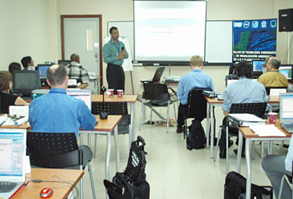
Supply of NASA Research Results and Demand from Decision Makers: “You Can’t Push a Rope”
Demand for application of NASA satellite-based research results is high; lacking ground obs.
Application
Science
Demand for scientific knowledge is high
NASA ESD has a large supply of R&A results for application and unique scientific expertise
SERVIR has established the protocol for delivering products to both decision makers and scientists

Slide 5
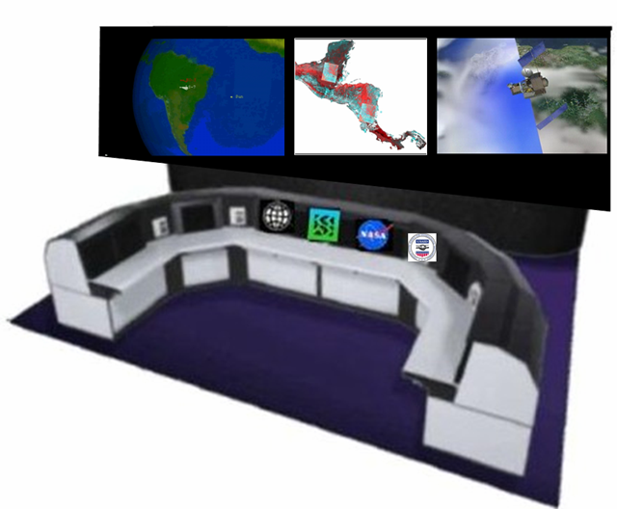
SERVIR Concept - 2003
Meeting of Environmental Ministers
  Lack of Access to Satellite Data
  Disparate Data Source
  Lack of Integration of In Situ Datasets
  Variety of Thematic Needs in Region
    Fire Detection
    Land Cover/Land Use
    Forest Monitoring
    Red Tides
    Climate Change
    Short Term Weather
    Drought Monitoring
    Carbon Flux
    Hot Spot Monitoring
    Disaster Mitigation
    Urban Studies

Slide 6
Initial SERVIR Framework
Land Cover/
Land Use
Change
Fires
Short Term
Weather
Prediction
Test Bed
Coastal Studies/
Coral Reefs
SERVIR REGIONAL
OPERATIONAL
FACILITY
Climate Change
Modeling
Flooding
Rapid
Response
IT and
Visualization
Other
In House
Capabilities
Plug-In
Capabilities
GUATEMALA
BELIZE
EL
SALVADOR
HONDURAS
NICARAGUA
COSTA
RICA
PANAMA
DOMINICAN
REPUBLIC

Slide 7
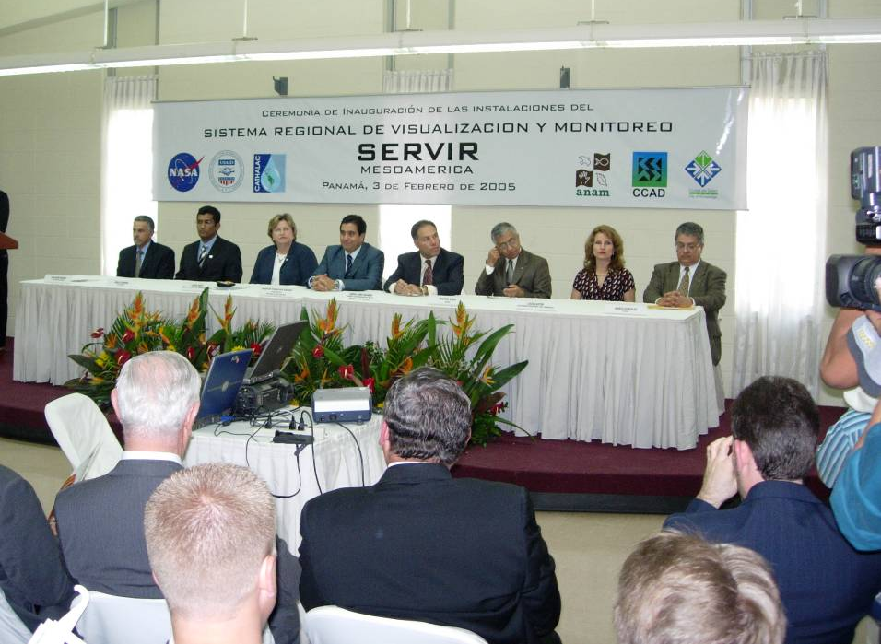
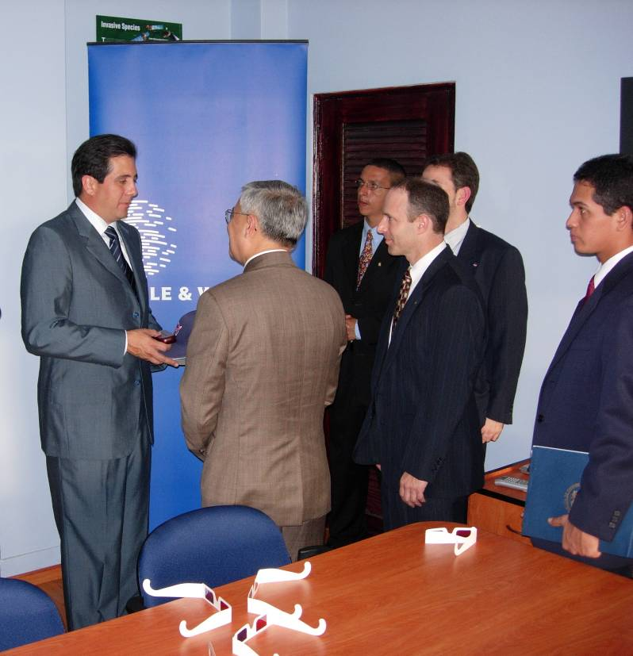

SERVIR Dedication
February 3, 2005

Slide 8
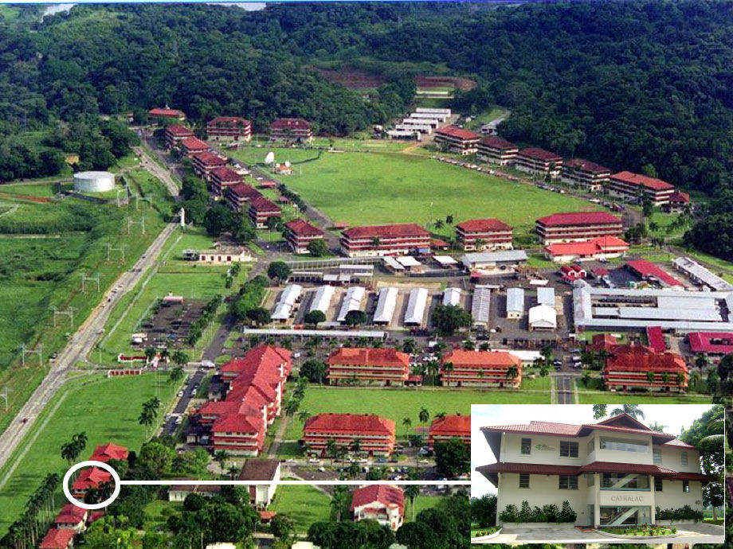
SERVIR @ CATHALAC in the City of Knowledge, Panama

Slide 9
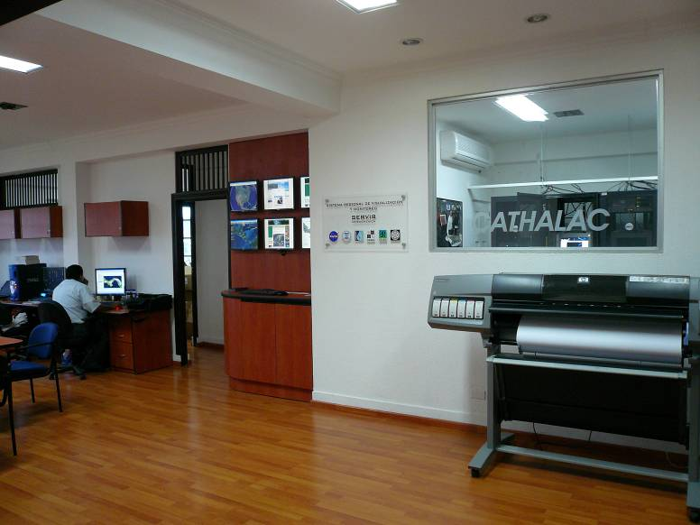
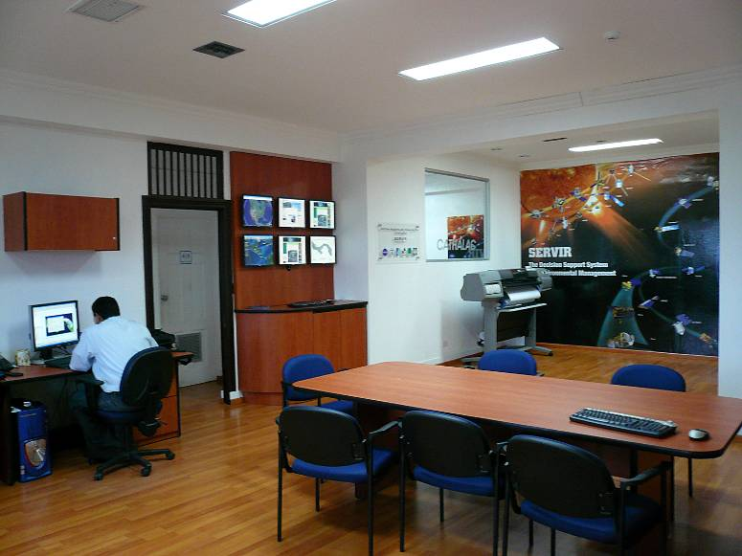
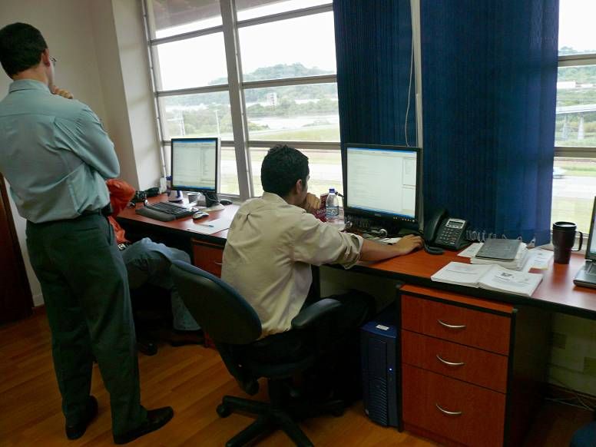
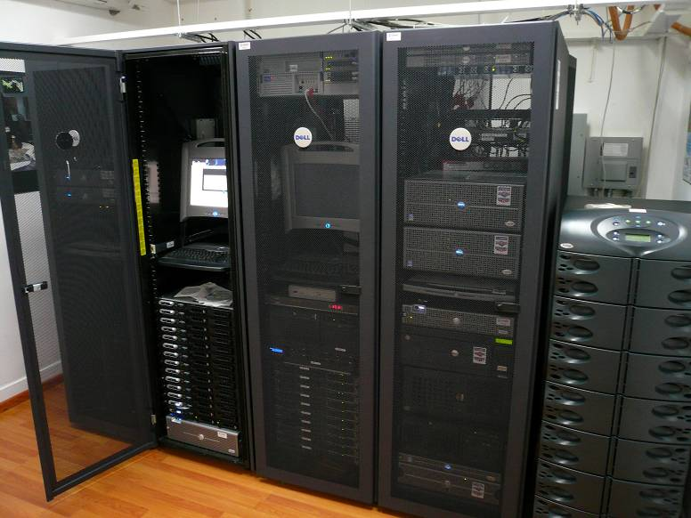
Inside SERVIR Regional Node

Slide 10
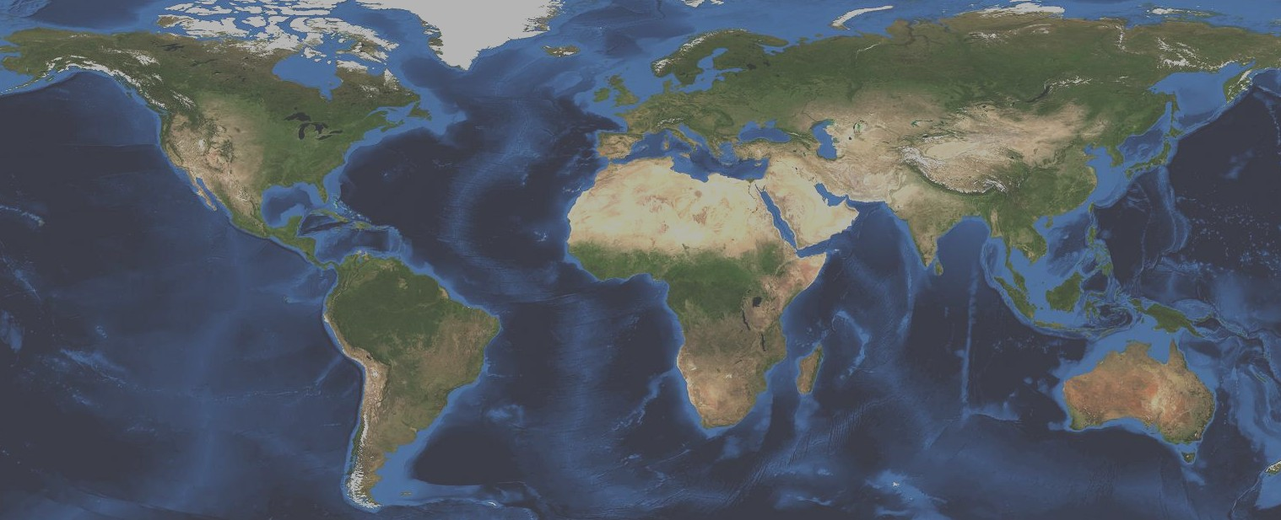

Current SERVIR Network
Possible Future SERVIR Network
SERVIR
Coordination Office
NASA/MSFC
Future Central
Asian Node
Future
West Africa Node
CATHALAC
Latin America
RCMRD
East Africa
Current Links
Future Links

Slide 11
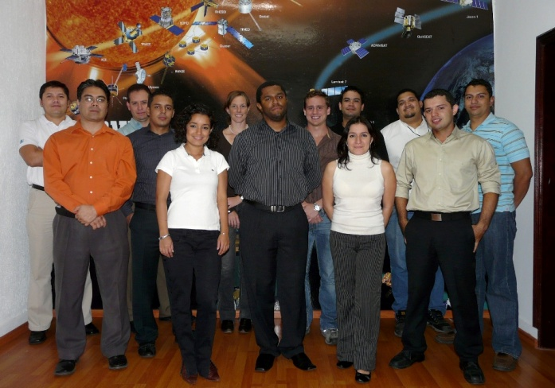
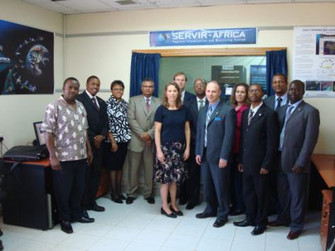
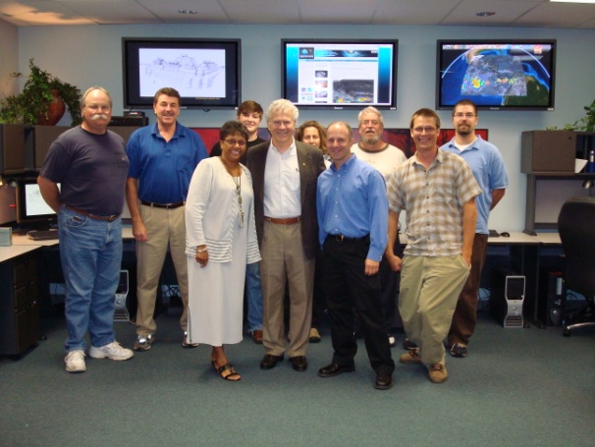
SERVIR Team
Building regional to national to local relationships through SERVIR geosciences platforms and people
SERVIR-Mesoamerica
Clayton, Panama
at CATHALAC
SERVIR-Africa
Nairobi, Kenya
at RCMRD
(With NASA/Goddard Space Flight Center Science/Applications Team)
SERVIR Test-Bed and Coordination Office
NASA/Marshall Space Flight Center
Huntsville, Alabama

Slide 12
SERVIR Platform: User Perspective
Discover
Managed knowledge base
Catalog services
Directory services
Notification services
Browse & search function
Share
Acquire
Metadata authoring tools
Community building tools
Feedback mechanisms
Reducing barriers to sharing
Ground receiving station
Data acquisition services
Data processing services
Data archive
Geodata services
Web portal
Use / Create/Decide
Visualization tools
Decision support tools
Forecasts and models
Support for interoperability
Support for product use
Current Priorities
Notes:
12

Slide 13
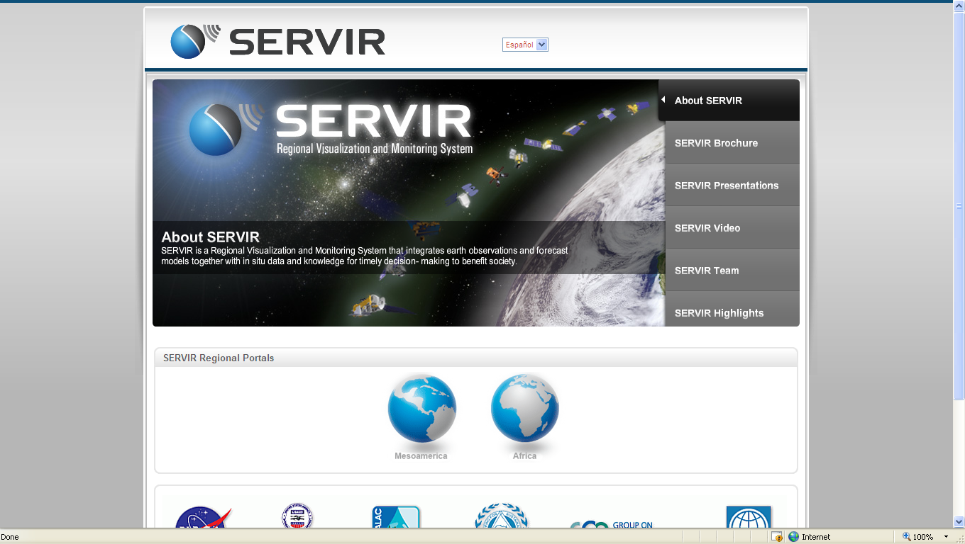
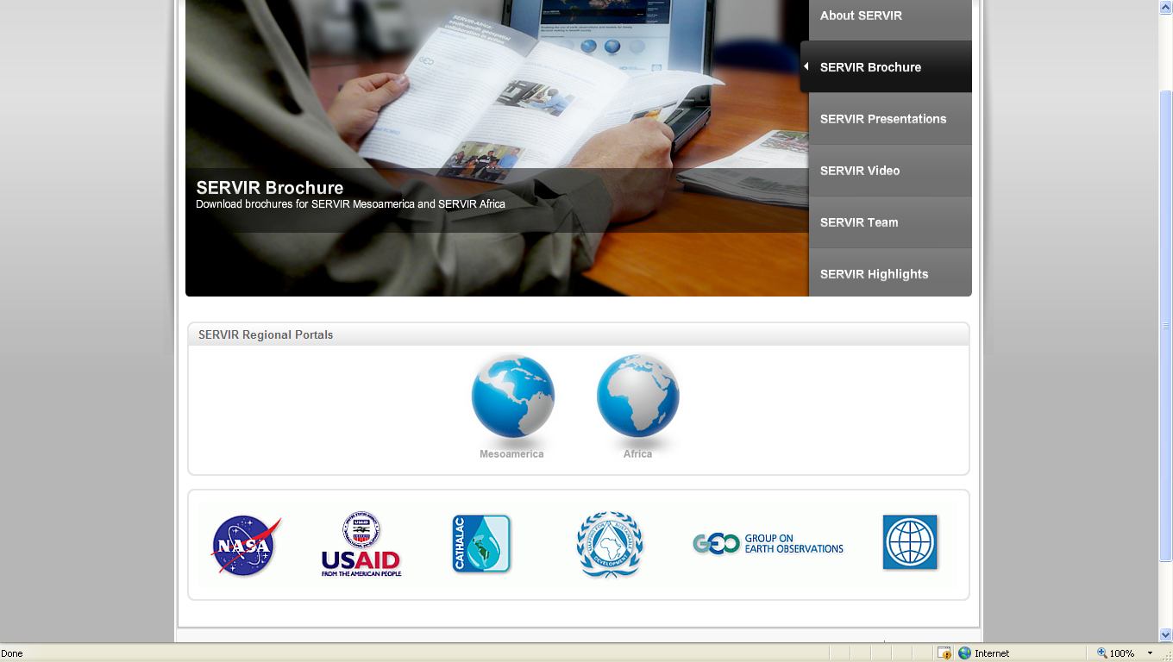
SERVIR Webpage

Slide 14
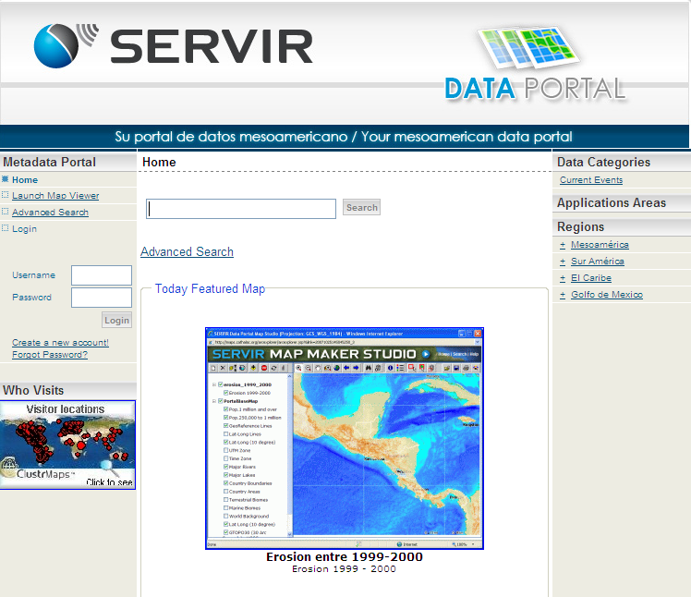
SERVIR Data Portal

Slide 15
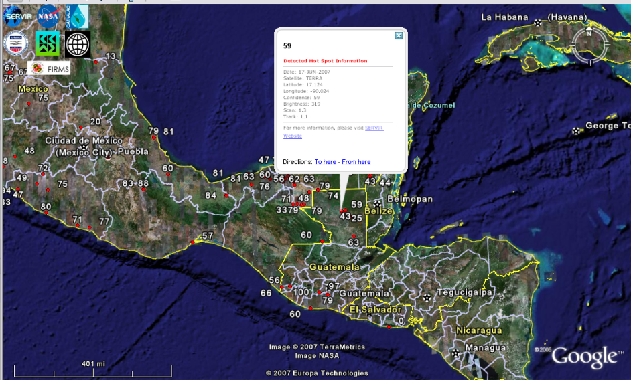
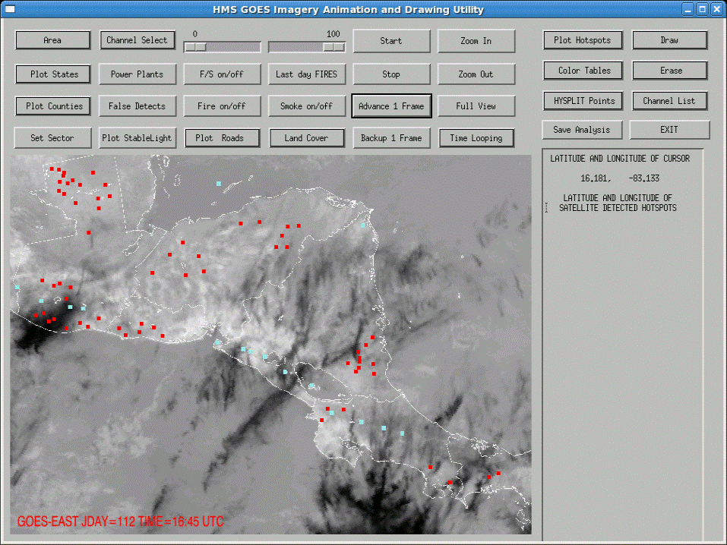
Decision Support: Fires

Slide 16
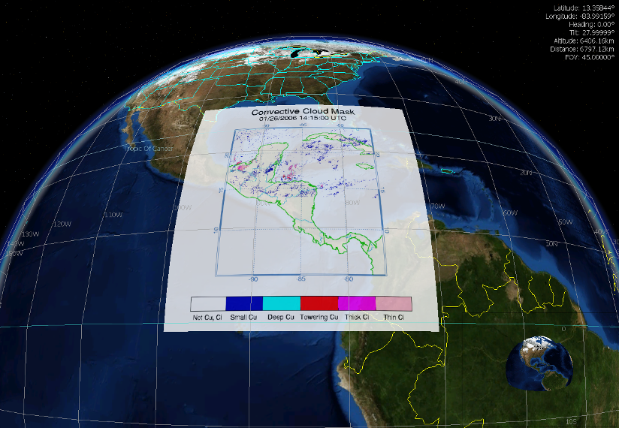
Decision Support: Nowcasting

Slide 17
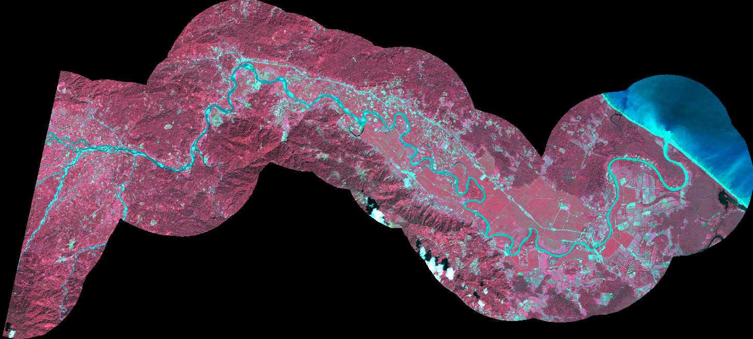

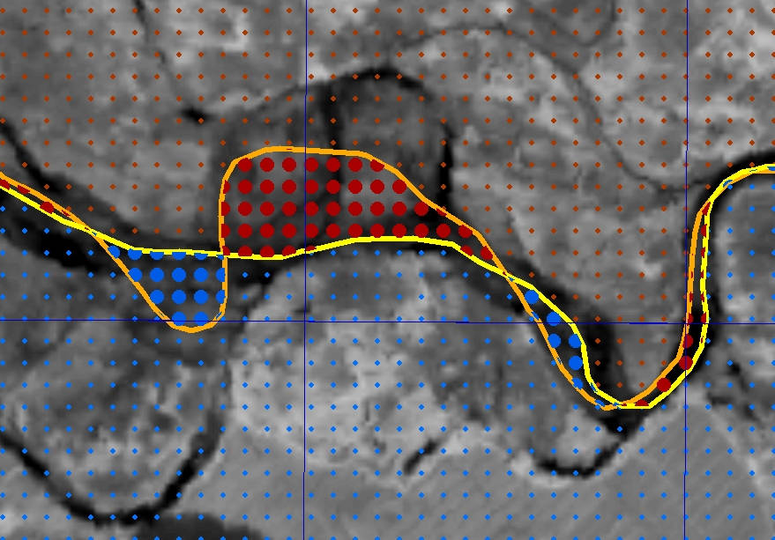
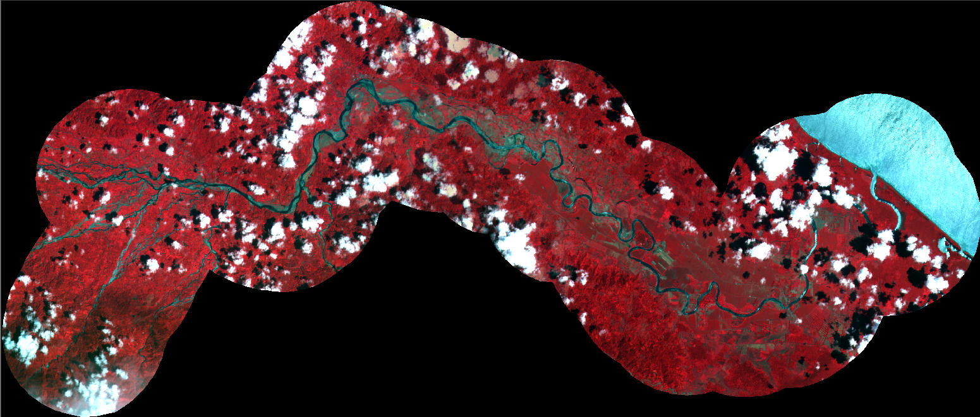
Decision Support: International Boundary Disputes
Pre-Flood
ASTER
Post-Flood
Red - Panamanian Land Now on Costa Rican Side of the Channel
Blue - Costa Rican Land Now on Panamanian Side of the Channel
SPOT

Slide 18
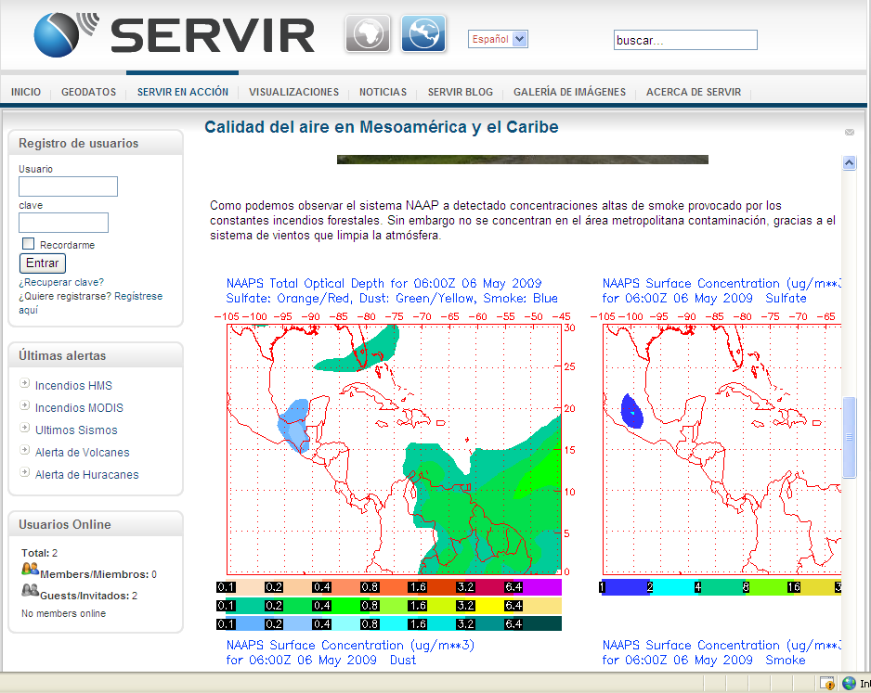
Decision Support: Air Quality

Slide 19
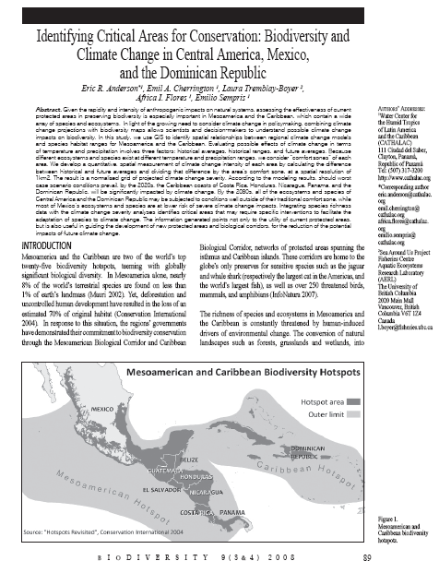
Climate Change and Biodiversity
Notes:
Countries are including results of this paper in their official national reports to the UN Convention on Climate Change

Slide 20
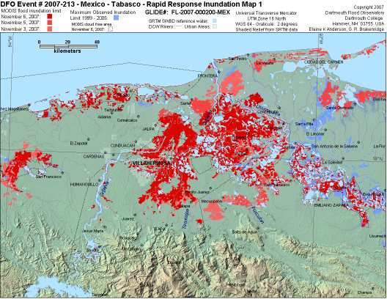
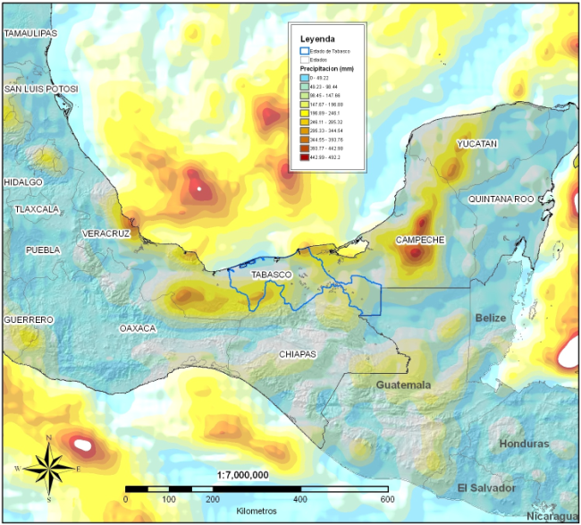
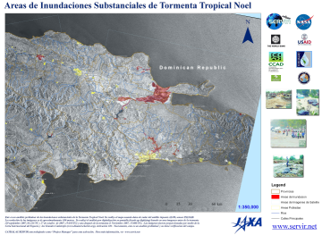
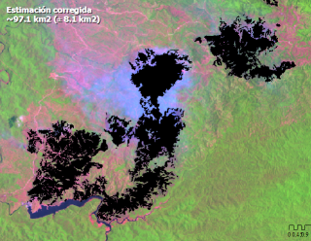
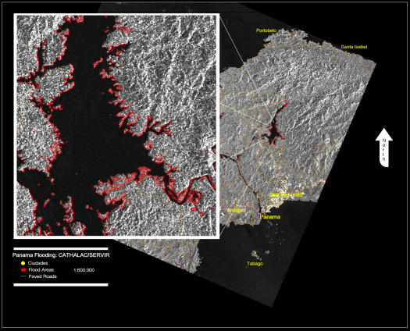
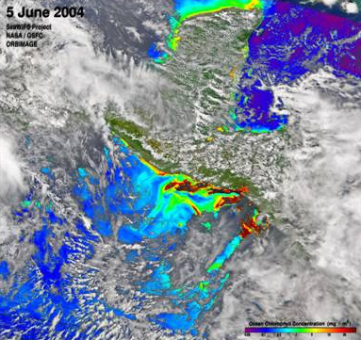
SERVIR Disaster Response (2004-2009)
Floodings
Tabasco, 2007
Landslides
Rep. Dominicana, 2007
Forest fire analisis
Belice, 2007
Flooding
Panamá, 2006/2008
Red Tide
El Salvador, 2004

Slide 21
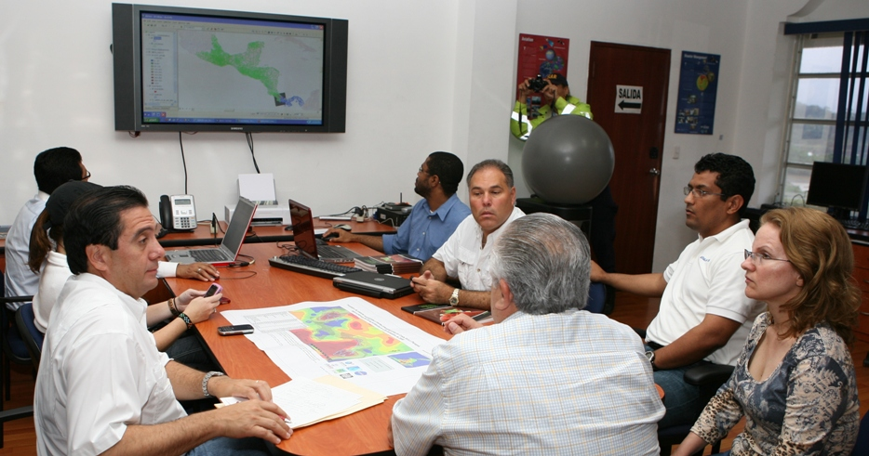
Where did NASA and NOAA satellite data go? Thanks to USAID and CATHALAC… To the desk of the President of Panama!
SERVIR decision support on the spot (Nov 2008)

Slide 22
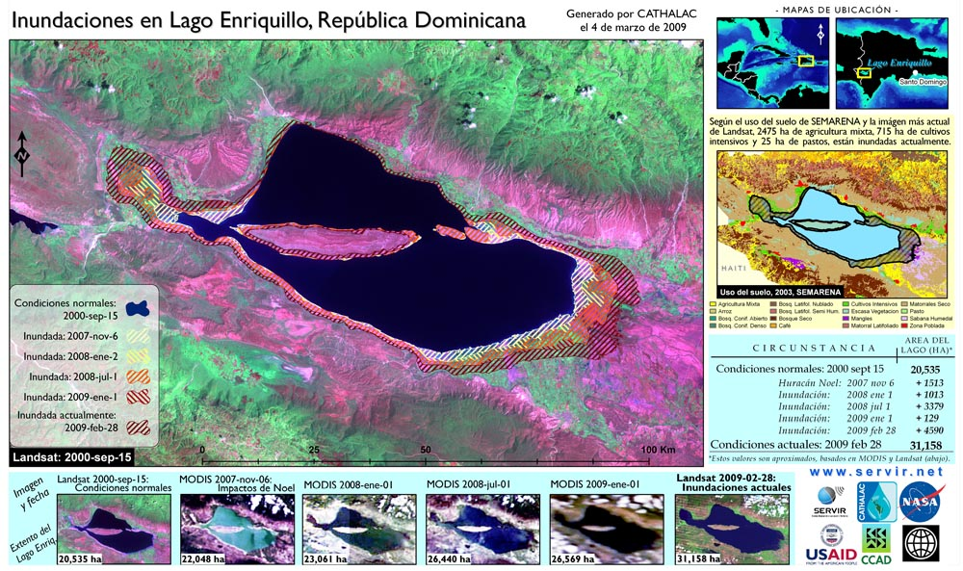
Flooding – Dominican Republic

Slide 23
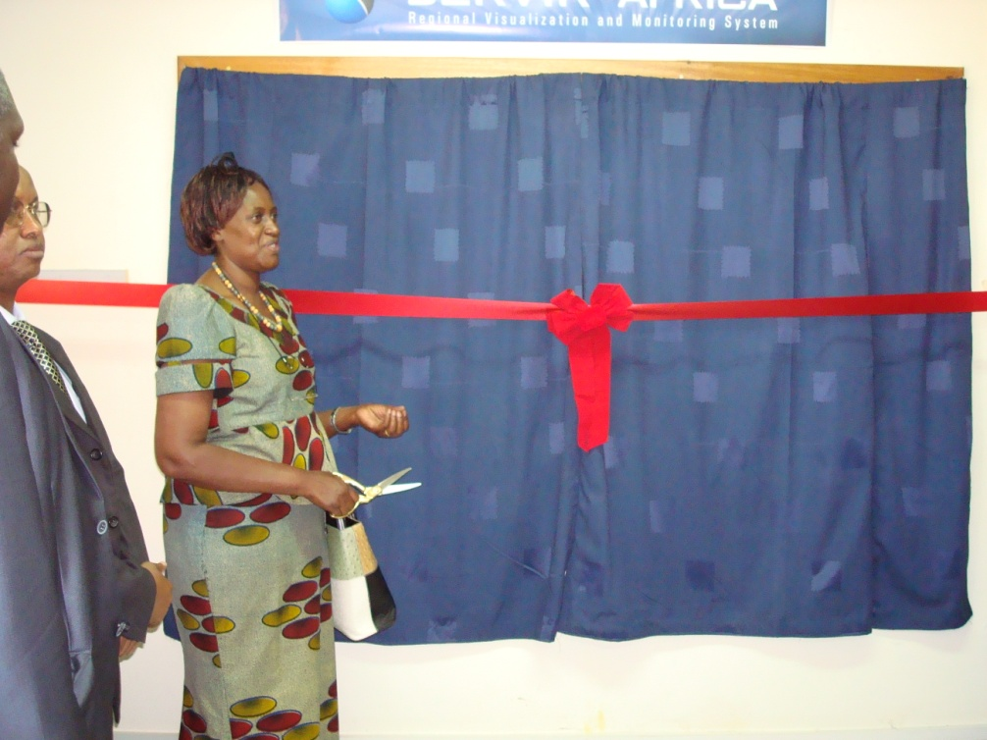

SERVIR-Africa Dedication:
November 21, 2008
Located at the Regional Center for
Mapping of Resources for Development
In Nairobi, Kenya

Slide 24
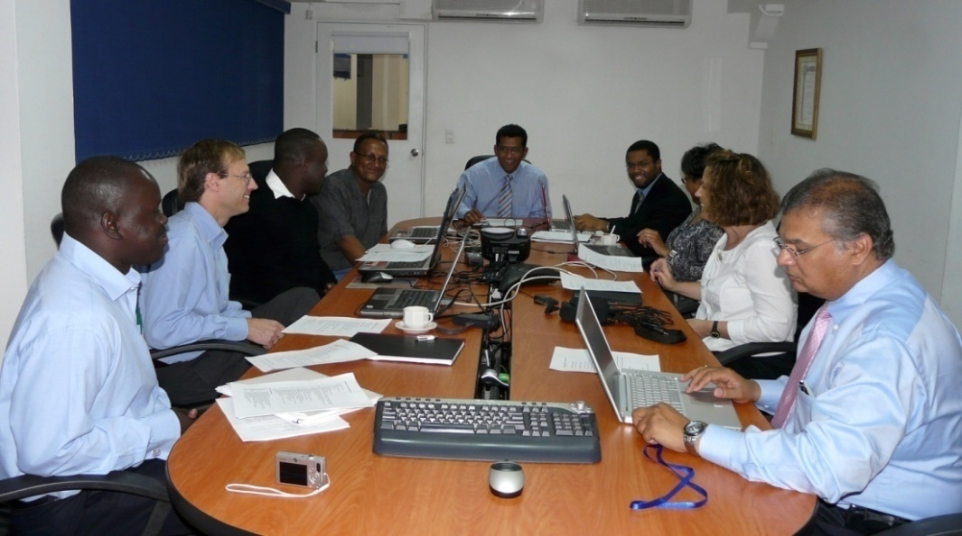
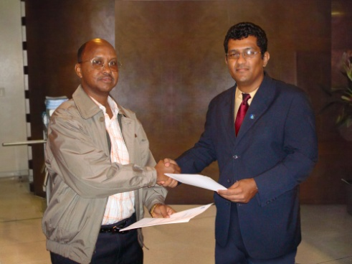
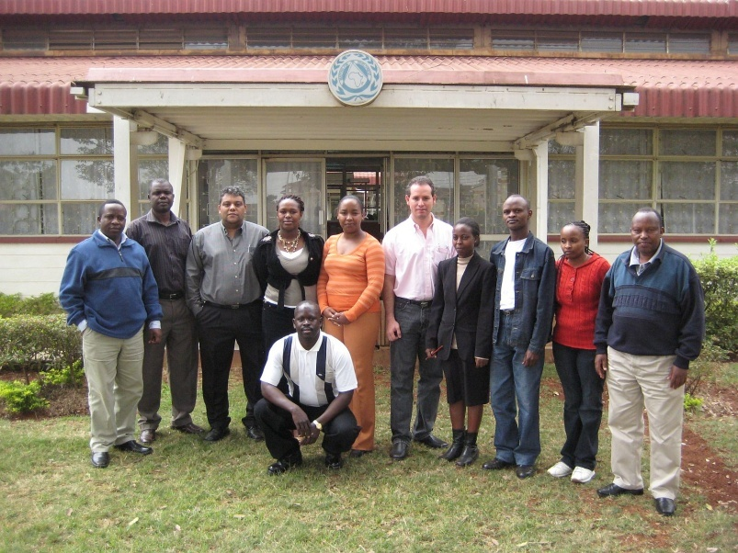
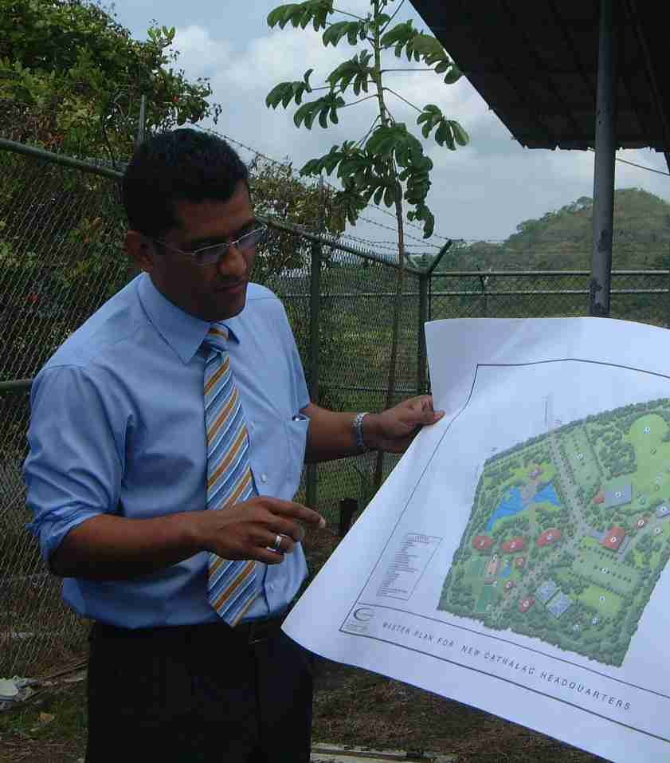
‘South-South’ collaboration
RCMRD travels to CATHALAC to observe Panama operations
CATHALAC travels to RCMRD
Both centers exchange ideas, share experience

Slide 25

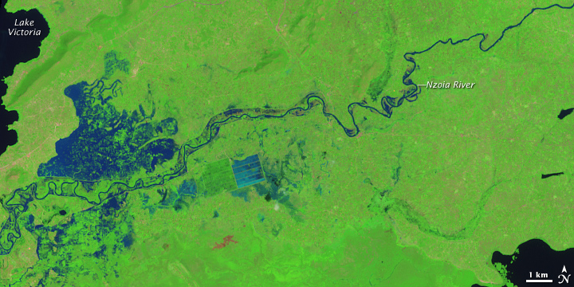
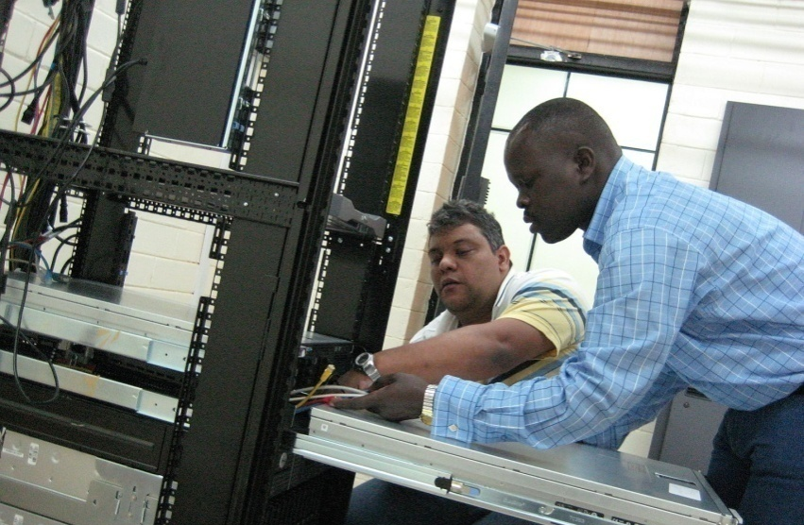
SERVIR-Africa: overview
Launched in November 2008
Functioning South-South exchange between SERVIR nodes on two continents
Inventory and cataloguing of African geospatial datasets – geospatial “one stop” discovery
Providing initial flood forecasting, flood mapping, and Rift Valley Fever probability using NASA science results
Training and capacity building
Strengthening collaboration between NASA centers (NASA/MSFC and NASA/GSFC) and other USG agencies
Flooding in Kenya near Lake Victoria as detected by NASA’s EO-1 satellite
Central Americans and Africans working together to build SERVIR-Africa system

Slide 26
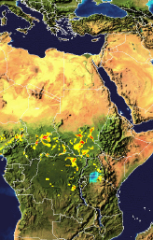
Flood Potential & Forecast Mapping
Using a regional/global hydrologic model with near-real time precipitation from the multi-sensor NASA TRMM 3B42 precipitation product to derive flood potential
Provides an estimate of expected depth of flood inundation at a 0.25 degree resolution (approx. 25 km)
Precipitation forecast data can be used with the model to provide longer lead time forecasts
Model
TRMM 3B42 Precipitation
Flood Potential

Slide 27
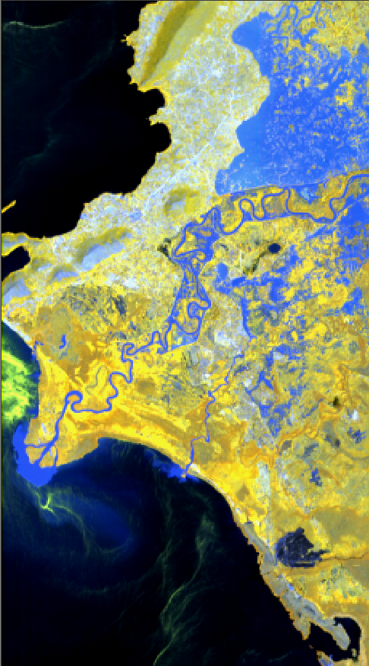

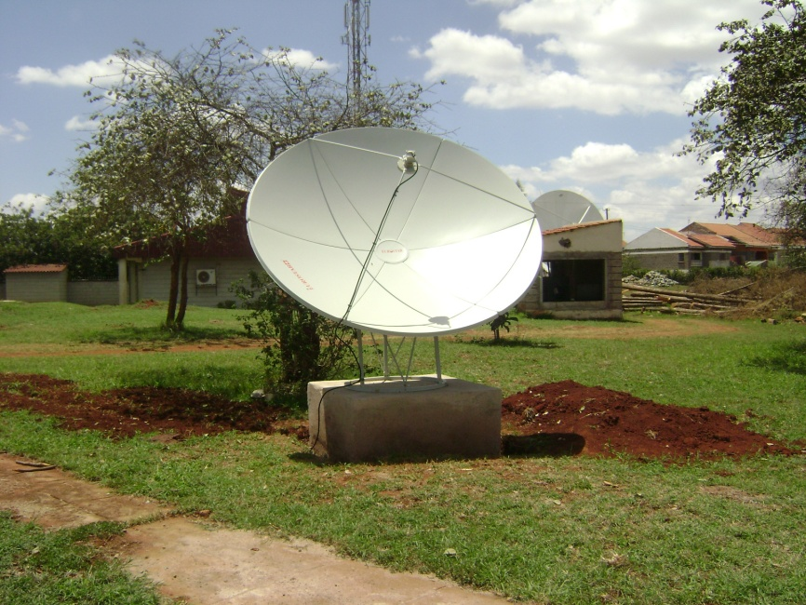
New opportunities for data acquisition
NASA’s tasking request system for EO-1 to acquire baseline and post-event imagery of flooded areas.
ENVISAT & GEONETcast receivers installed at RCMRD
Budalang’i Floods
November 13, 2008
Notes:
RCMRD now has ability to make direct requests of NASA’s Earth Observing-1 satellite

Slide 28
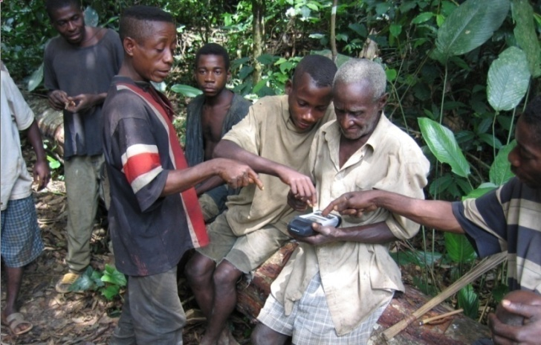
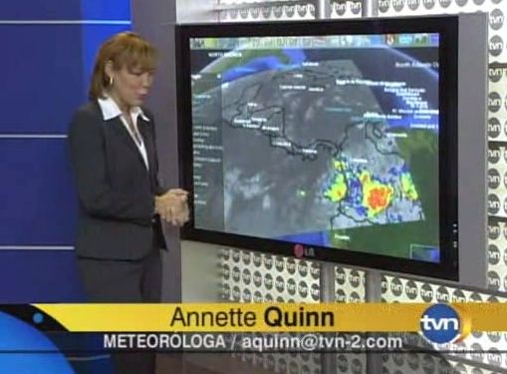
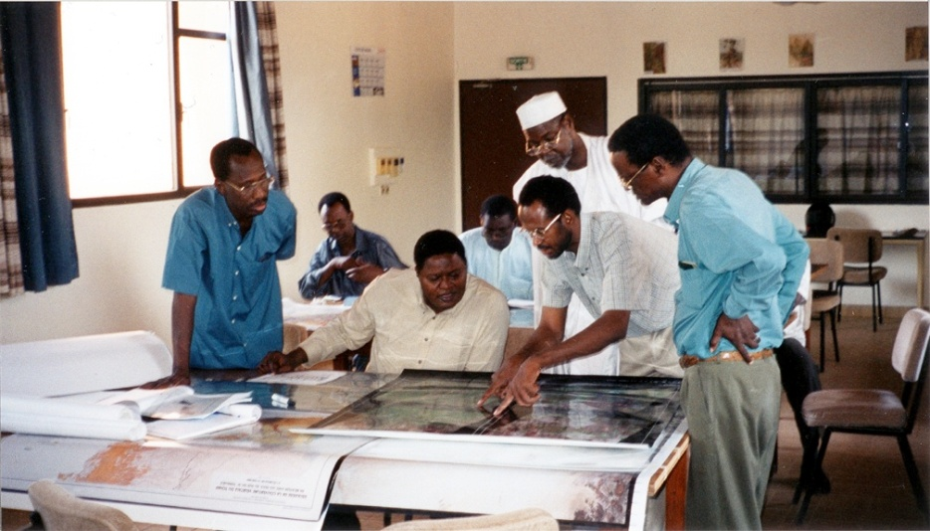
Users
Decision makers, media, educators, students, private industry, community groups.

Slide 29
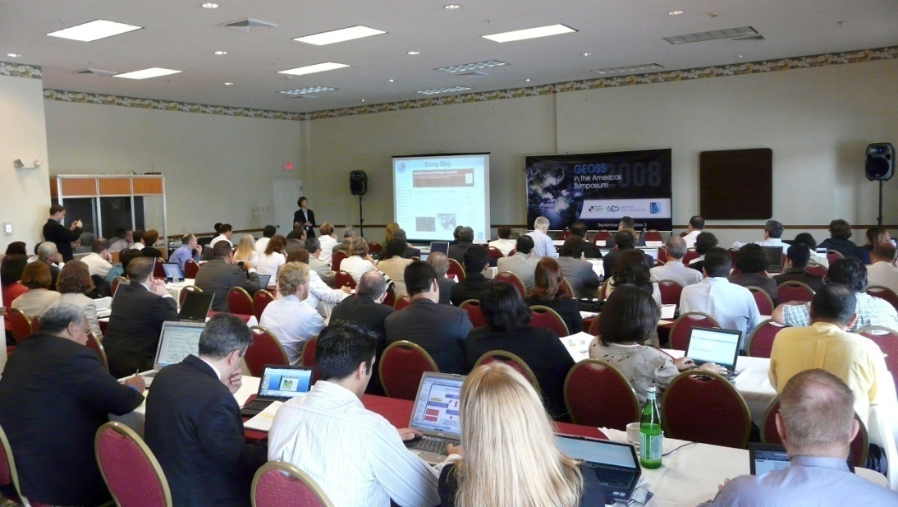
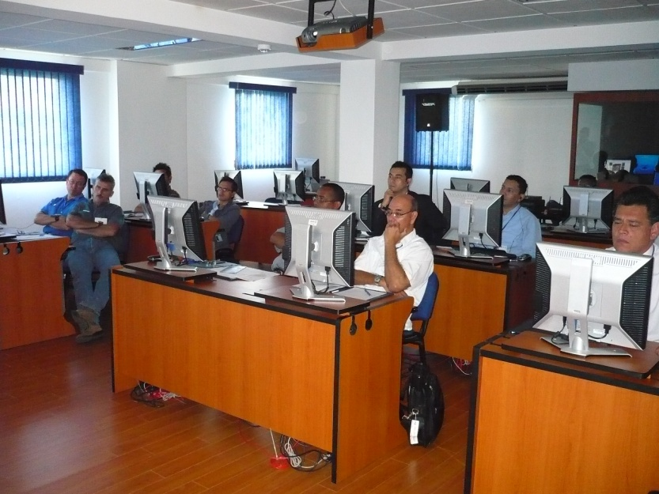
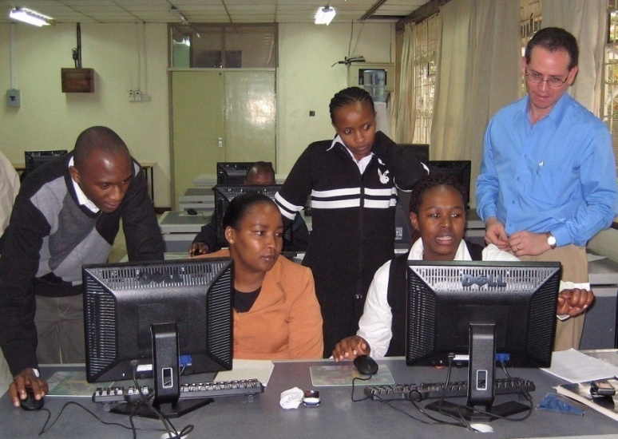
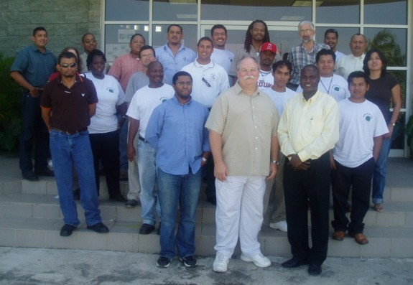
Training & Capacity Building

Slide 30
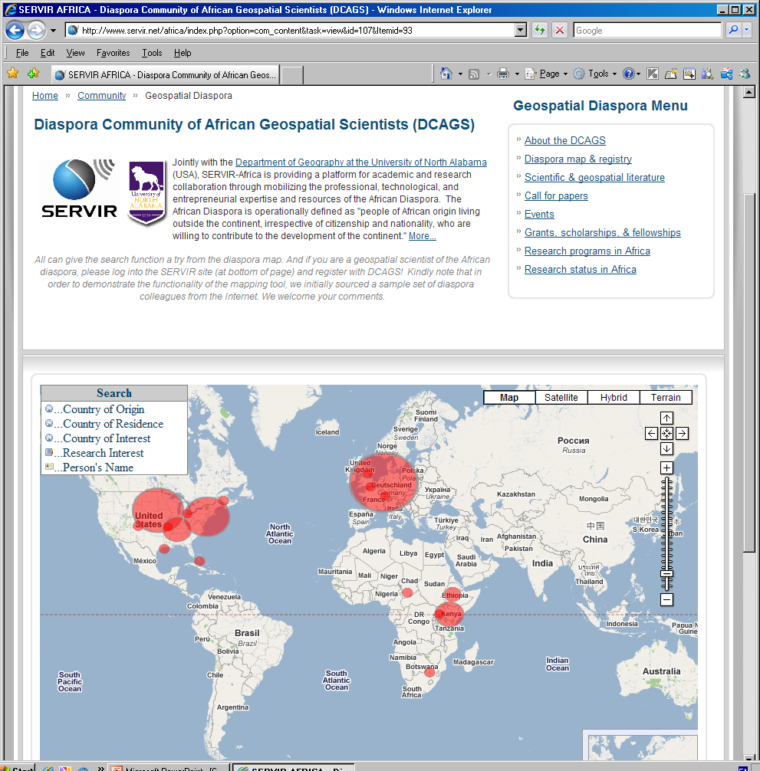


Directory Services (e.g., African geospatial diaspora)
Tools and services to facilitate networking and cooperation among African geospatial scientists, projects and organizations
Notes:
30

Slide 31

Challenges
USA
“48 States”
Limited band width
Large geographic scope
India
Argentina
China 9,596,960 km²
USA 9,363,071
India 3,287,590
Europe 4,936,973
Argentina 2,766,890
New Zealand 268,680
TOTAL : 30,220,164 km²
Area of Africa: 30,318,830 km²
Source: World Factbook, 2004
Europe
New Zealand
China
Notes:
Large geographic scope & Limited band width

Slide 32

Publish or Die
Promote Adaptive Management or Die
Fuente: CEPREDENAC 2000

Slide 33
The Future: From an Applied R&D Project to an Intergovernmental Mandated Assessment & Monitoring Program
2006 – UNEP Ministerial Decision to coordinate committee to mainstream EO into Environmental Decision Making in LAC
2007- Project Manager for the UN International Charter for Space and Major Disasters
2007 - Recognized as GEOSS Early Achievement
2007 – Commissioned to develop & implement the Environmental Information System for the US-CAFTA-DR

Slide 34


The Future: From an Applied R&D Project to an Intergovernmental Mandated Assessment & Monitoring Program
2008 –Commissioned by the European Union PREVDA to mainstream EO into watershed management in vulnerable areas
2008 – Acknowledged in the Central American and the Caribbean Presidential Summit on Climate Change

Slide 35


The Future: From an Applied R&D Project to an Intergovernmental Mandated Assessment & Monitoring Program
2008 -Commissioned to manage USAID’s Climate One-Stop
2008 – Presidential Mandate to Coordinate the LMSRR

Slide 36
The Future: From an Applied R&D Project to an Intergovernmental Mandated Assessment & Monitoring Program
Node Expansion to Other Regions
Campus in Panama
Formal Capacity Building Program
Hardware
  Unmanned Aerial Vehicles (UAVs)
  Nanosats
Joint Research and Development Projects
Trust Fund

Slide 37

The Future: From an Applied R&D Project to an Intergovernmental Mandated Assessment & Monitoring Program

Slide 38


































SERVIR Mesoamerica Collaborators
Implementing Agencies
Environmental Ministries
US Government
Other Space Agencies
NGOs/Non-Profits
Universities
Institutes Associations
Business/Industry
Other: Disaster Charter (CONAE), CENAT, etc.

Slide 39
















SERVIR-Africa Collaborators
Implementing Agencies
Government agencies
KMD
NGOs/Non-Profits
Universities
Business/Industry

